Slide 1
Secure Data Hiding In Images Using Steganography
CAPSTONE PROJECT
Presented By : D.SIVA KUMAR
Student Name: D.SIVA KUMAR
College Name : SIDDHARTH INSTITUTE OF ENGINEERING & TECHNOLOGY,PUTTUR
Department : COMPUTER SCIENCE & INFORMATION TECHNOLOGY

Slide 2
OUTLINE
Problem Statement
Technology used
Wow factor
End users
Result
Conclusion
Git-hub Link
Future scope

Slide 3
Problem Statement
Traditional encryption methods make data transmission obvious to attackers.
Need for covert data transmission without raising suspicion.
Cybersecurity threats require advanced secure communication methods.
Steganography allows embedding secret data within digital images, ensuring secure transmission.

Slide 4
Technology used
Programming Language: Python
Image Processing Library: OpenCV
Python Libraries Used : OpenCV – For image processing
File Handling & Security: Basic encryption logic for password protection
Platform: Windows 11

Slide 5
Wow factors
Invisibility: Data hidden without altering visual quality.
Dual Security: Combines steganography + encryption for layered protection.
High Capacity: Embed large data (text, files, or even other images).
Real-Time Applications:
Covert messaging in military ops.
Digital watermarking for copyright protection.
Resistance to Steganalysis : Advanced techniques evade detection tools.

Slide 6
End users
Government & Military: Secure communication of classified data.
Corporations: Protect intellectual property and trade secrets.
Journalists/Activists: Bypass censorship in restricted regions.
Healthcare: Securely share patient records.
General Public: Privacy in personal messaging (e.g., social media).

Slide 7
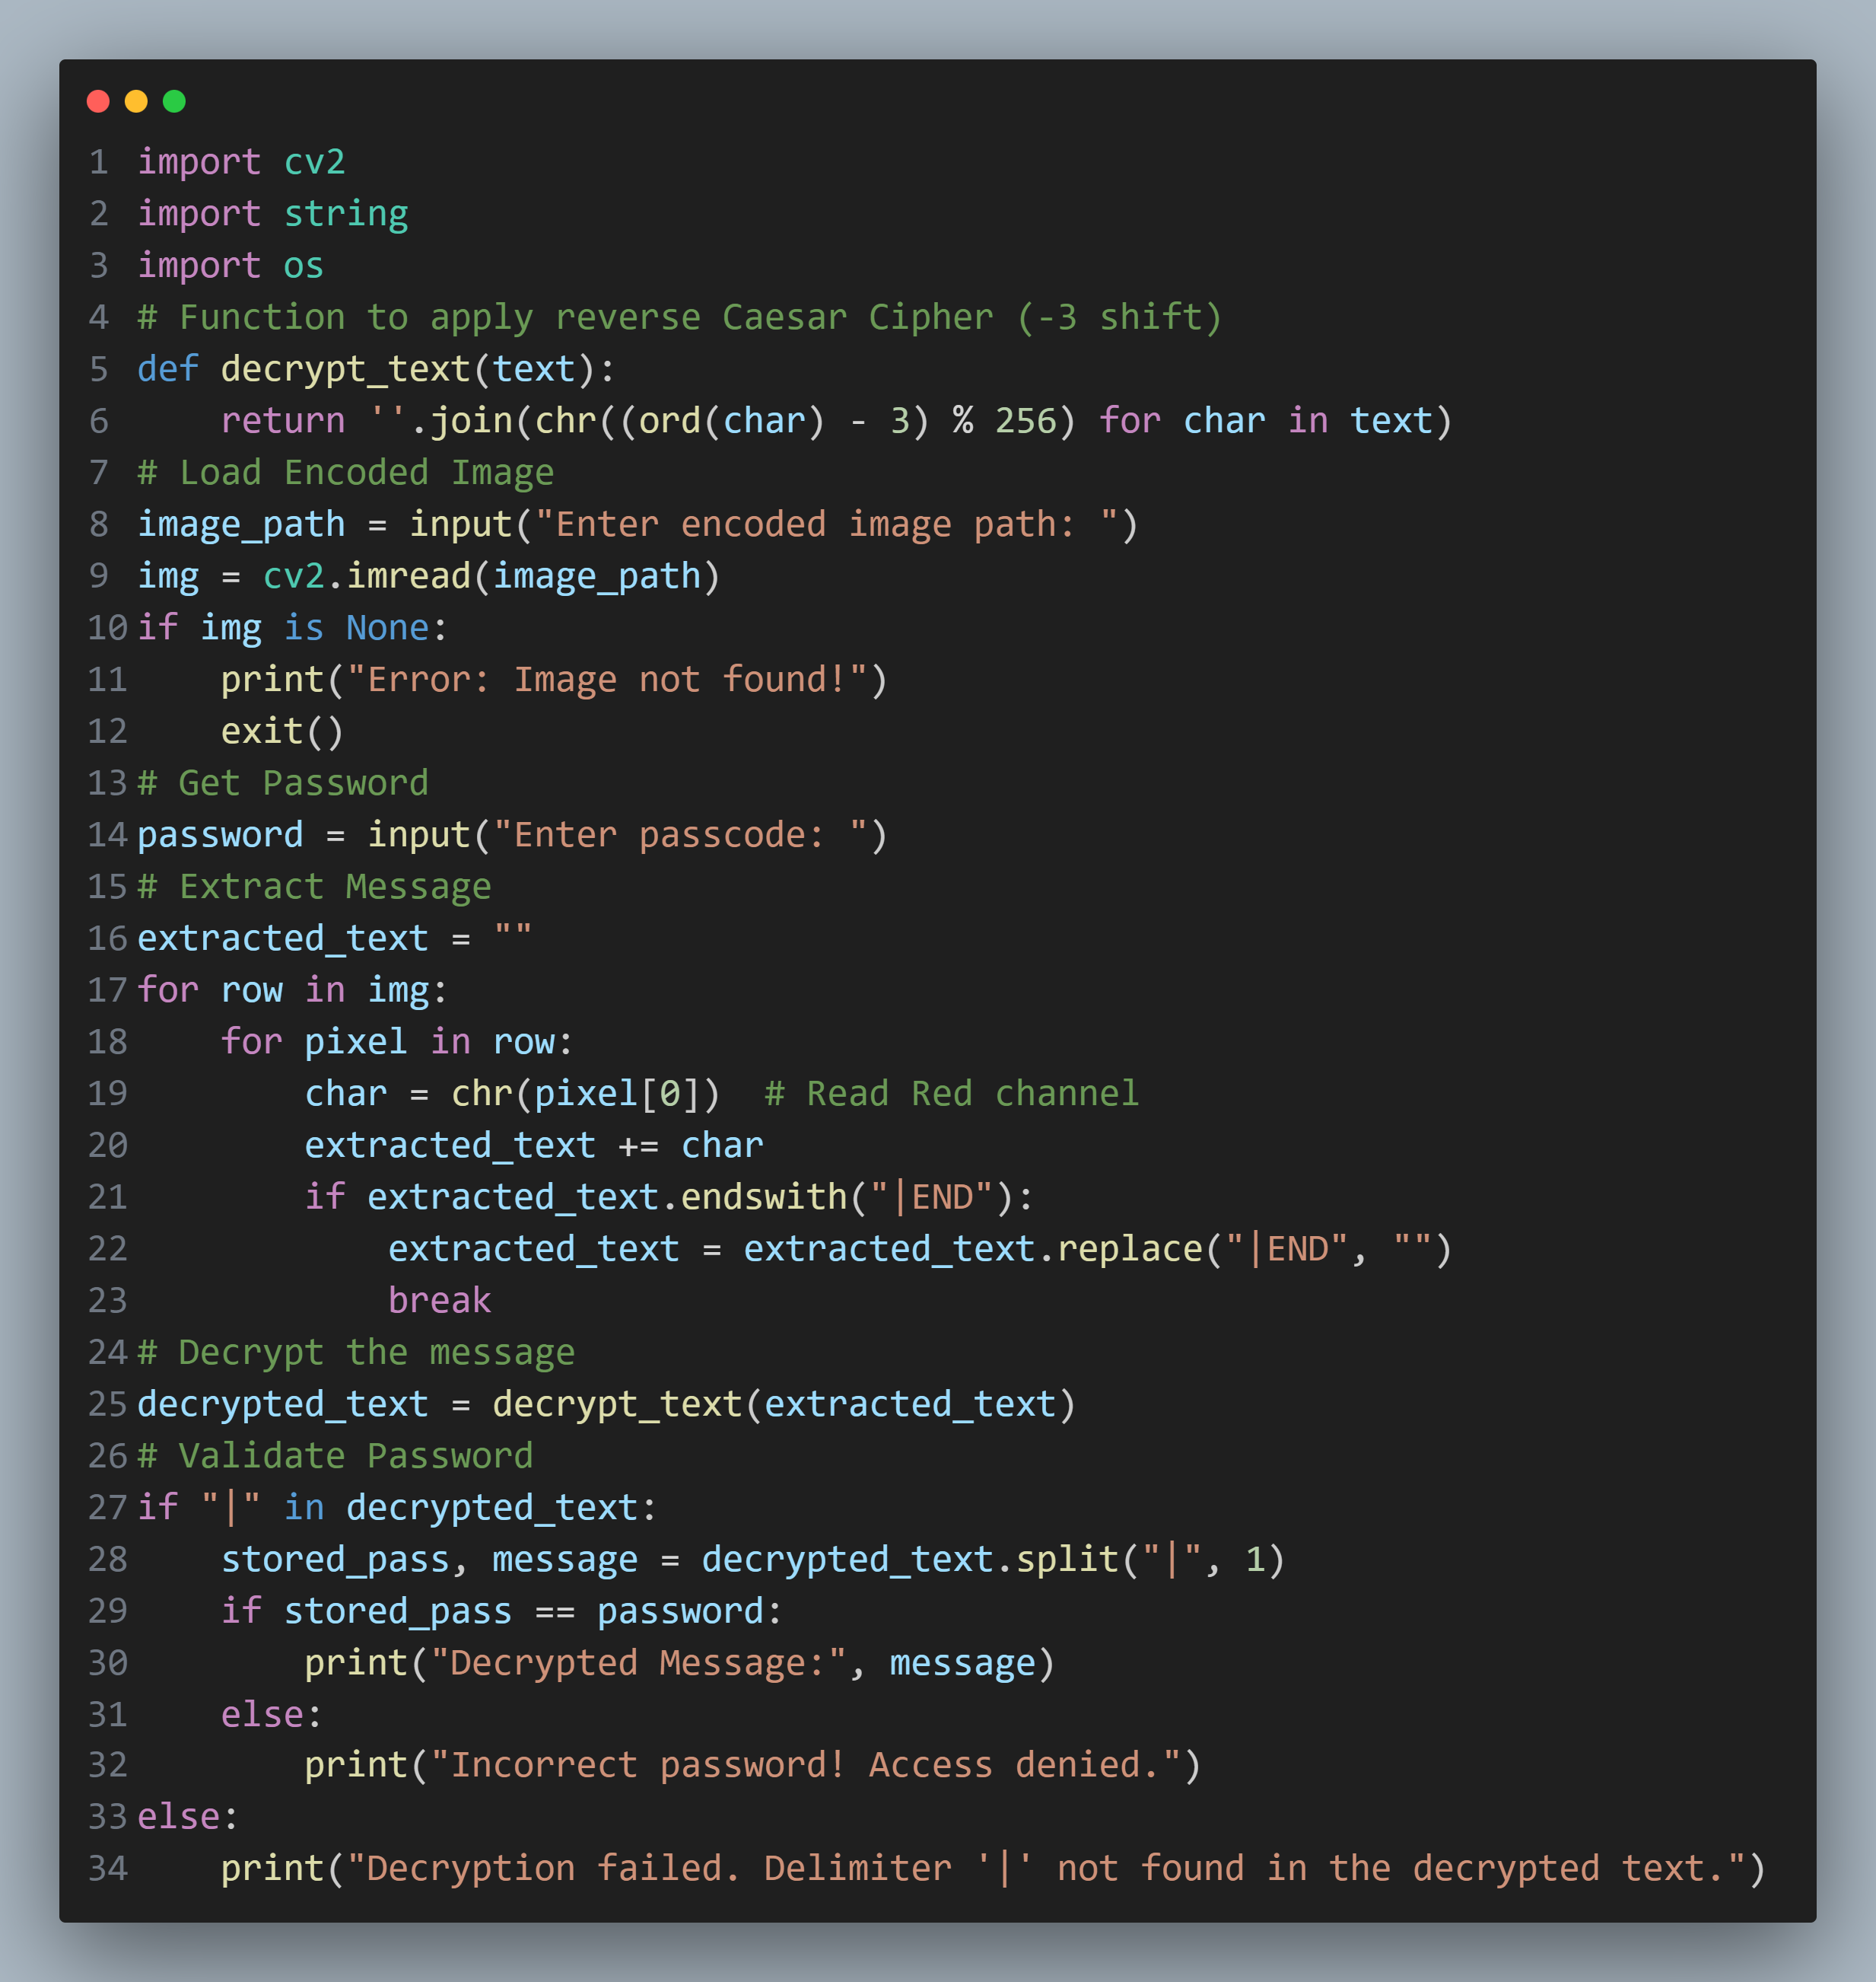
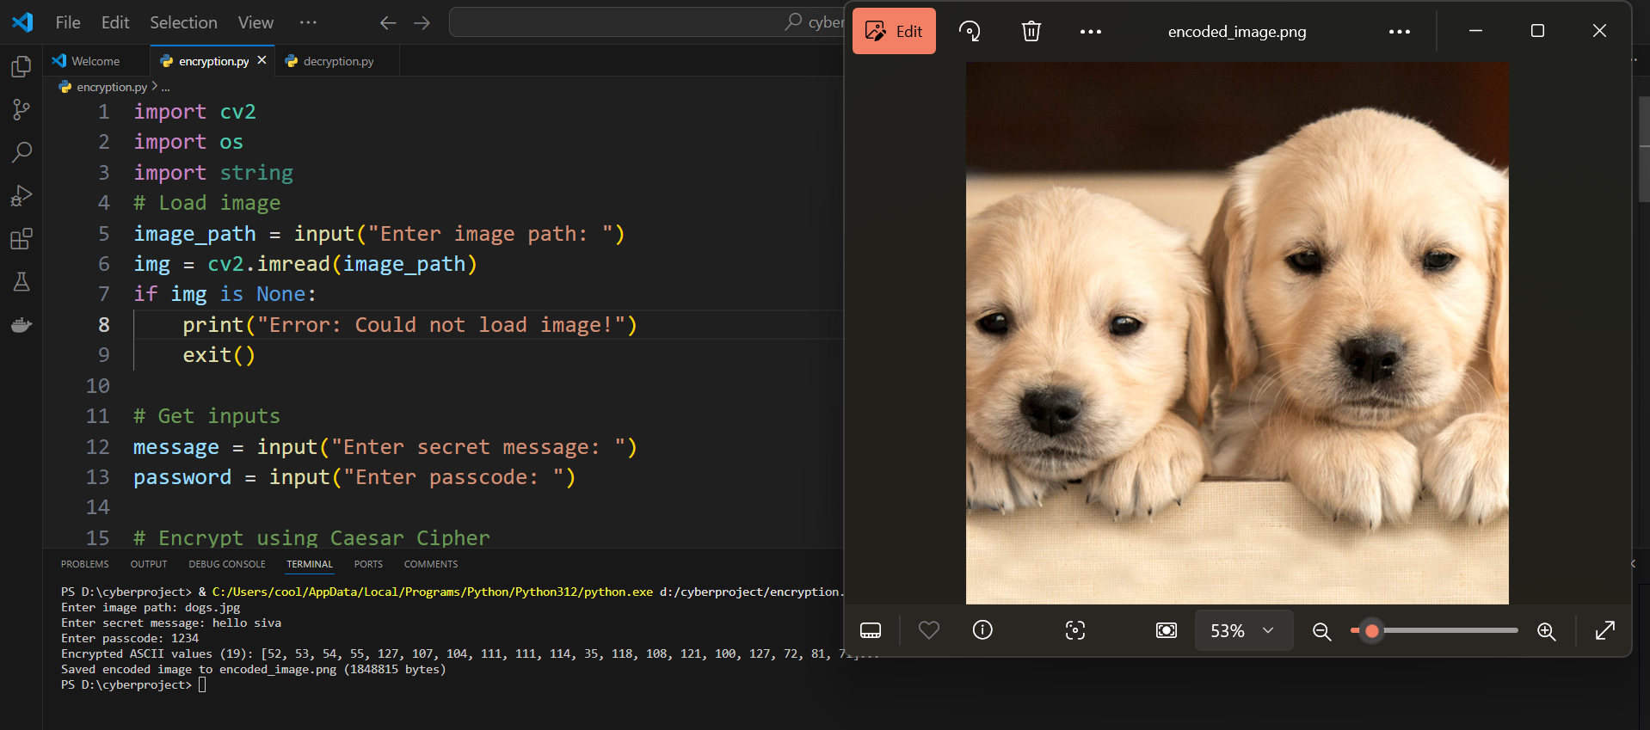
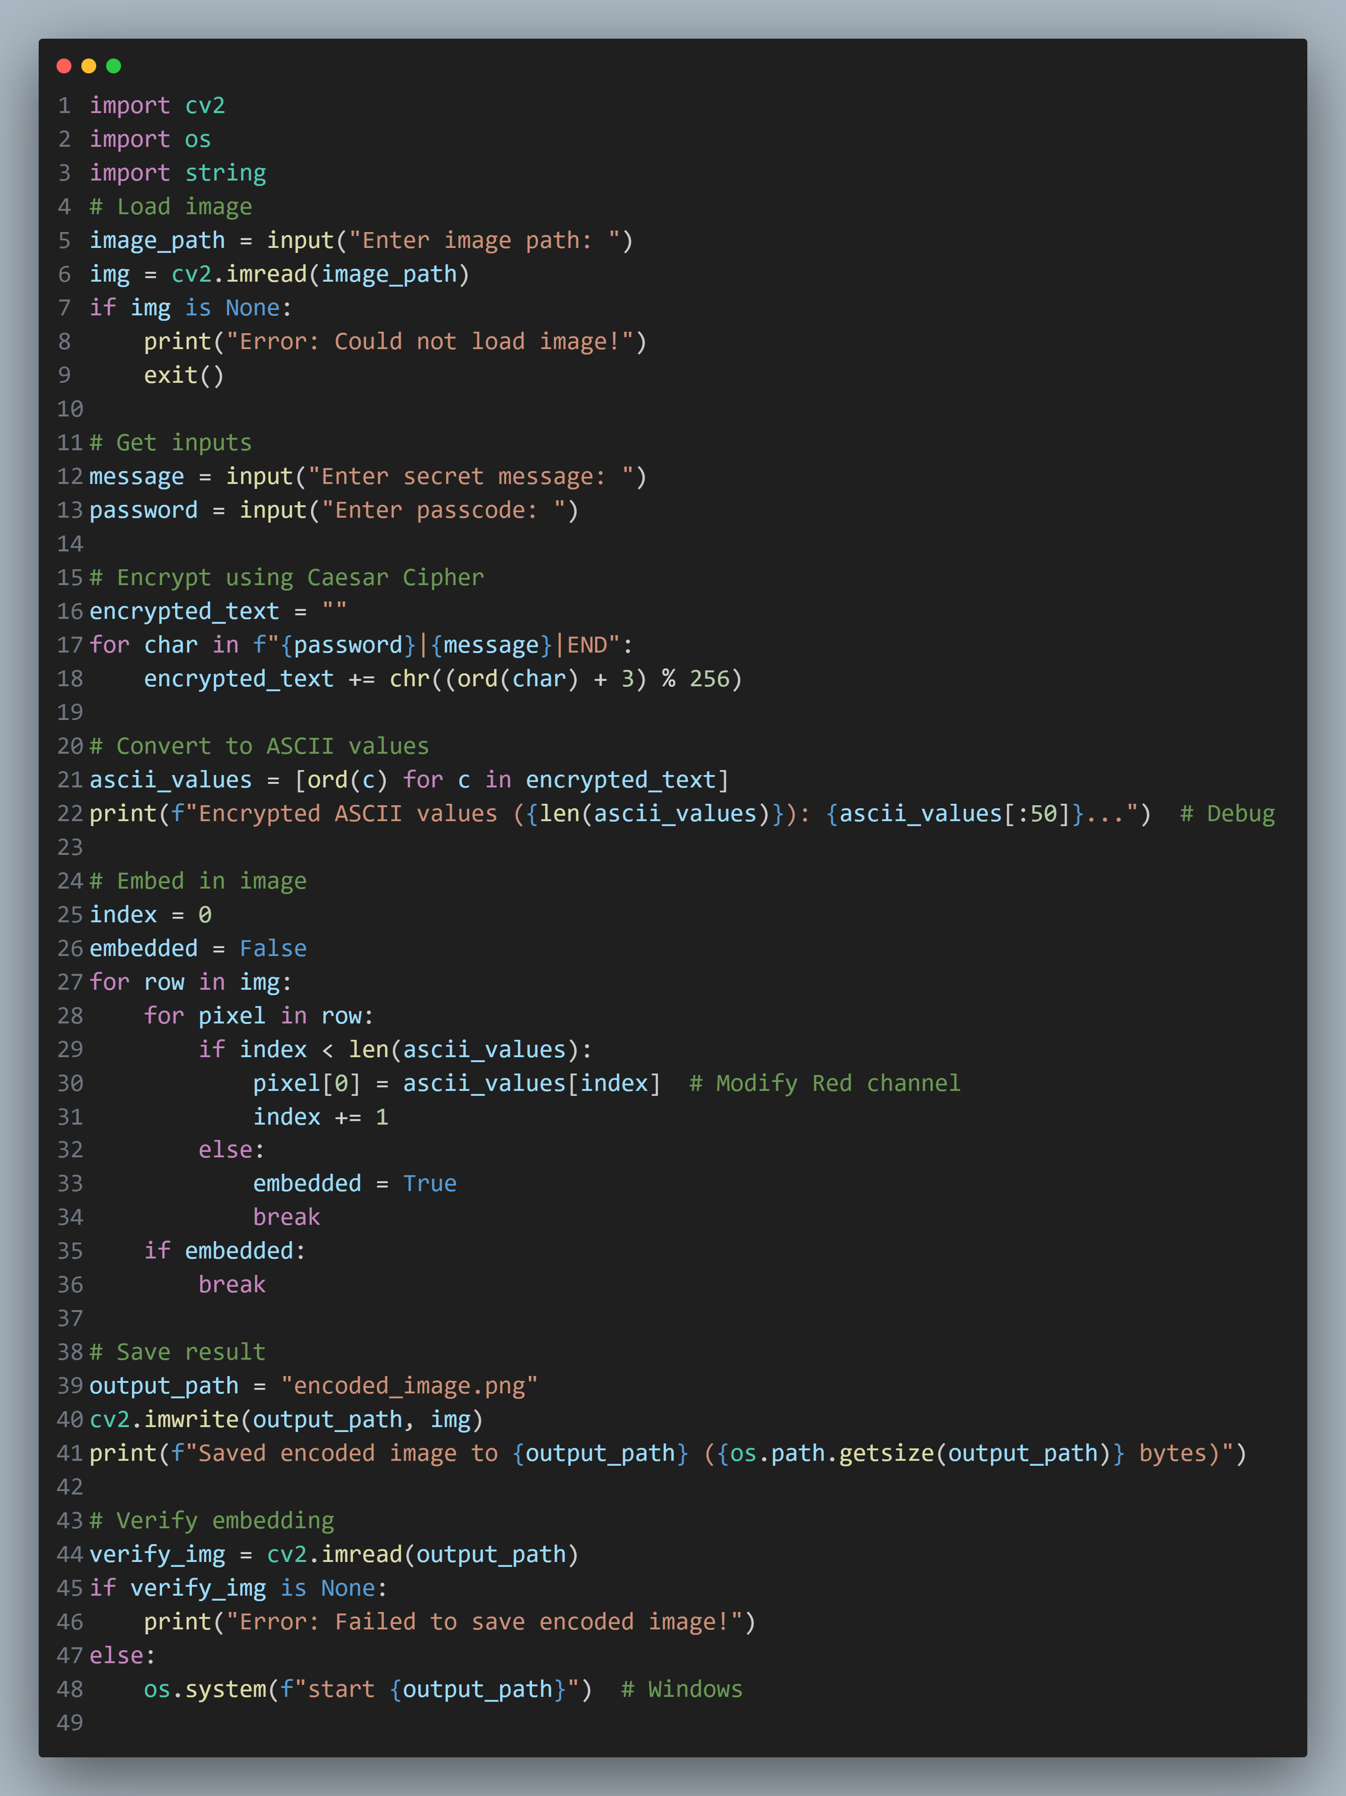


Results
Decryption Code:
Encryption Code:
Input Image File:
Output Image File:

Slide 8
Conclusion
Steganography provides invisible, secure communication by hiding data in plain sight.
Combined with encryption, it offers multi-layered security.
Versatile applications across industries like defense, healthcare, and media.
Limitations: Requires balancing capacity, visibility, and robustness.

Slide 9
GitHub Link
https://github.com/sivakumar0412/Steganography_project.git

Slide 10
Future scope
AI/ML Integration: Adaptive embedding based on image content.
Quantum Steganography: Resistant to quantum computing attacks.
Blockchain: Track tampering of stego-images.
IoT Security: Embed data in sensor-generated images.
Anti-Forensics: Improve resistance to advanced steganalysis tools.

Slide 11
THANK YOU

